Slide 1
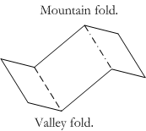
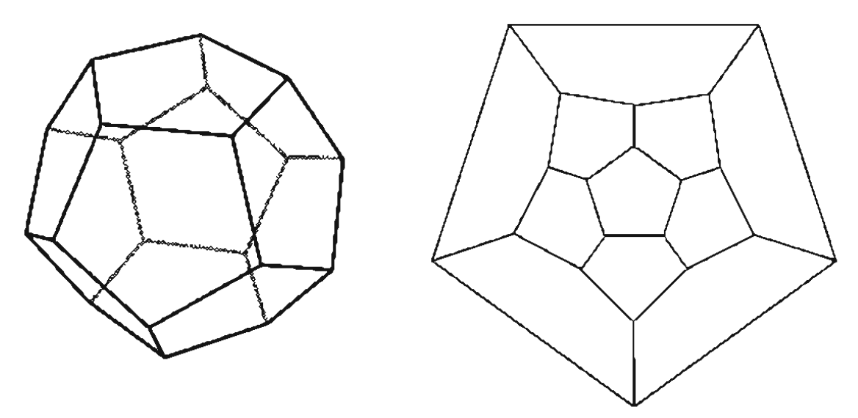
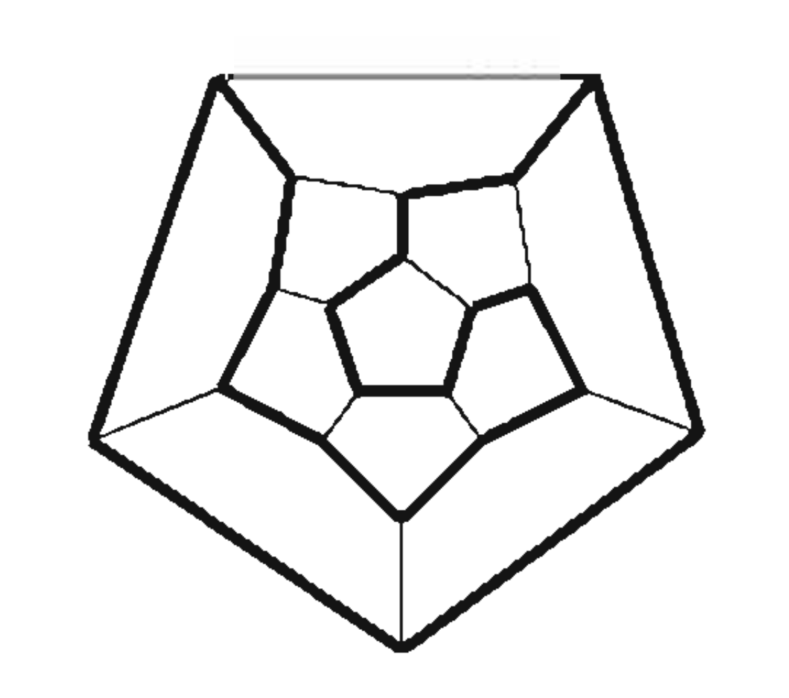
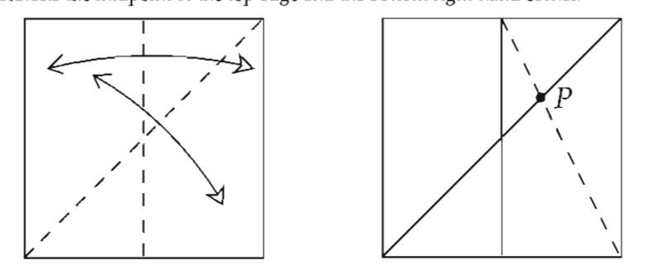
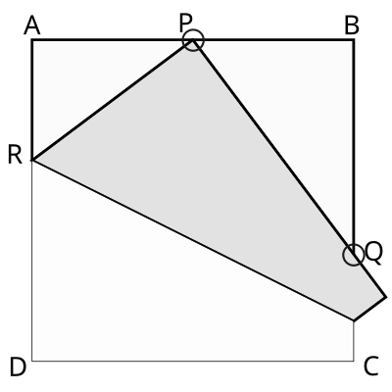
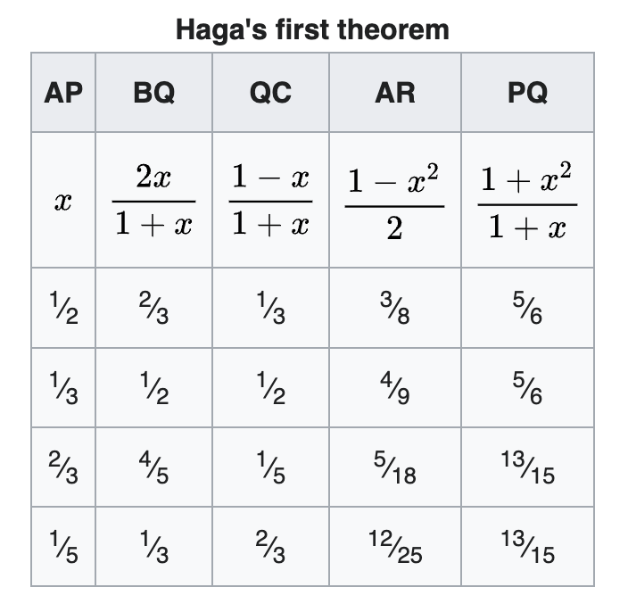
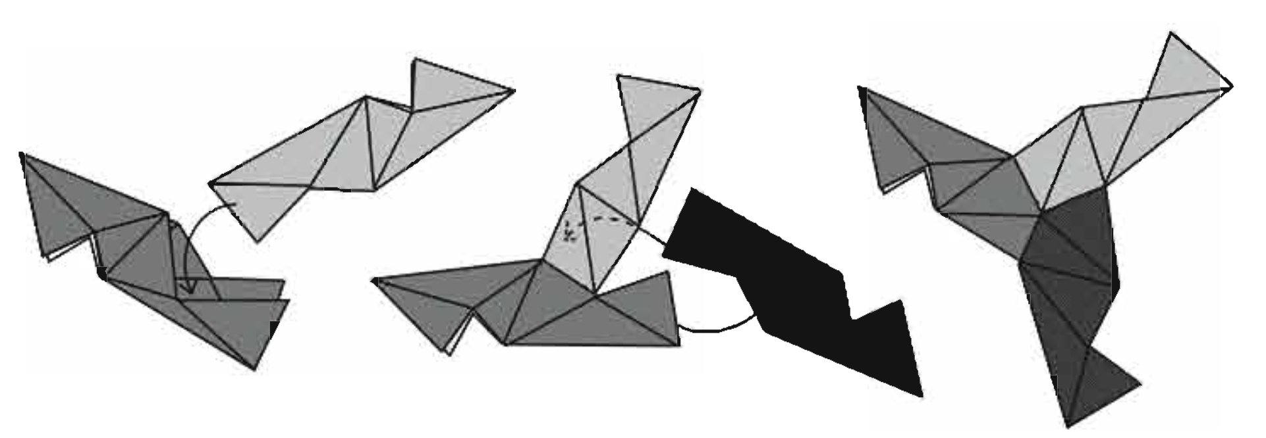
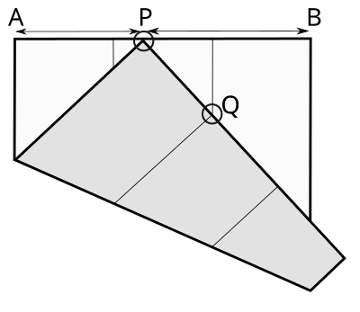
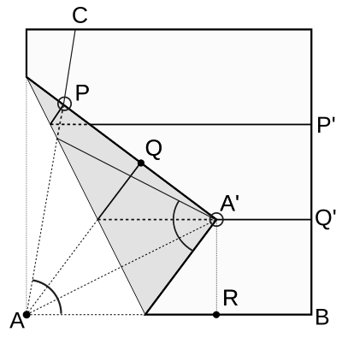
Modern Origami Applications By Ryan Y. Batubara
Joseph Wu: “Origami is the silent poetry of geometry."
Three Color Theorem (Graph Theory)
Given some 3D model made of PHiZZ units, one can construct a planar graph (a graph with no intersecting edges) that describes it:
A hamiltonian cycle is a path in a graph that starts at some vertex, visits every other vertex, before returning to the starting vertex.
Claim: All PHiZZ planar graphs have hamiltonian cycles, and thus are 3-edge-colorable. Corollary: Not all 3-regular (all vertices have 3 edges) planar graphs are hamiltonian.
Proof Sketch: Since each vertex is degree 3, by the Handshaking Lemma (∑ deg V = 2|E|) there must be an even number of vertices. Then the edges passed by the Hamiltonian circuit are 2-colorable, and all other edges can be given a third color such that no two colors are touching.
On Origami (折り紙)
Origami is the Japanese art of paper folding.
Creases refer to folds essential to a model.
Thus, each model has a unique crease pattern.
Diagonal Trisections (Algebra and Geometry)
It is impossible to trisect an angle using just a ruler and compass.
Proof sketch: Trisecting 60° is equivalent to computing cos(π/9), which satisfies an irreducible polynomial of degree 3. Since the only numbers that can be produced ruler-and-compass have power of two algebraic degrees, trisection is impossible.
However, one can trisect a piece of paper easily with origami:
Can this method be generalized to trisect any fold, say for example the diagonal fold? Experiment with the blue paper.
Haga’s First Theorem (Geometry)
Take a square paper, and fold the lower left corner to some point P on the top edge. Then APR, BPQ, QST, are similar.
T
S
Modular Origami (3D Geometry)
Modular Origami involves combining multiple units of paper together to create one model. One very famous unit is called the PHiZZ unit, which can be joined together in sets of three as follows:
Haga’s Division (Geometry)
Haga’s Theorem allows us to arbitrary divide a side. Try divide the yellow paper into three equal rectangles.
Activities, proofs, and illustrations inspired/taken from:
“Project Origami: Activities for Exploring Mathematics” by Thomas Hull in 2006
“Origami Design Secrets” second edition by Robert Lang in 2012
“Twists, Tilings, and Tessellations” by Robert Lang in 2018
ANSWERS:
Unique Crease Patterns: The provided pattern can be folded 6 ways; yes.
Diagonal Trisections: Yes, and this can be generalized to any fold.
Page 1

Slide 2
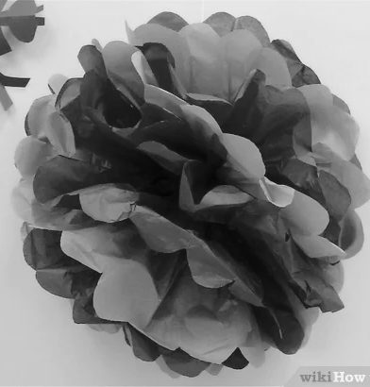

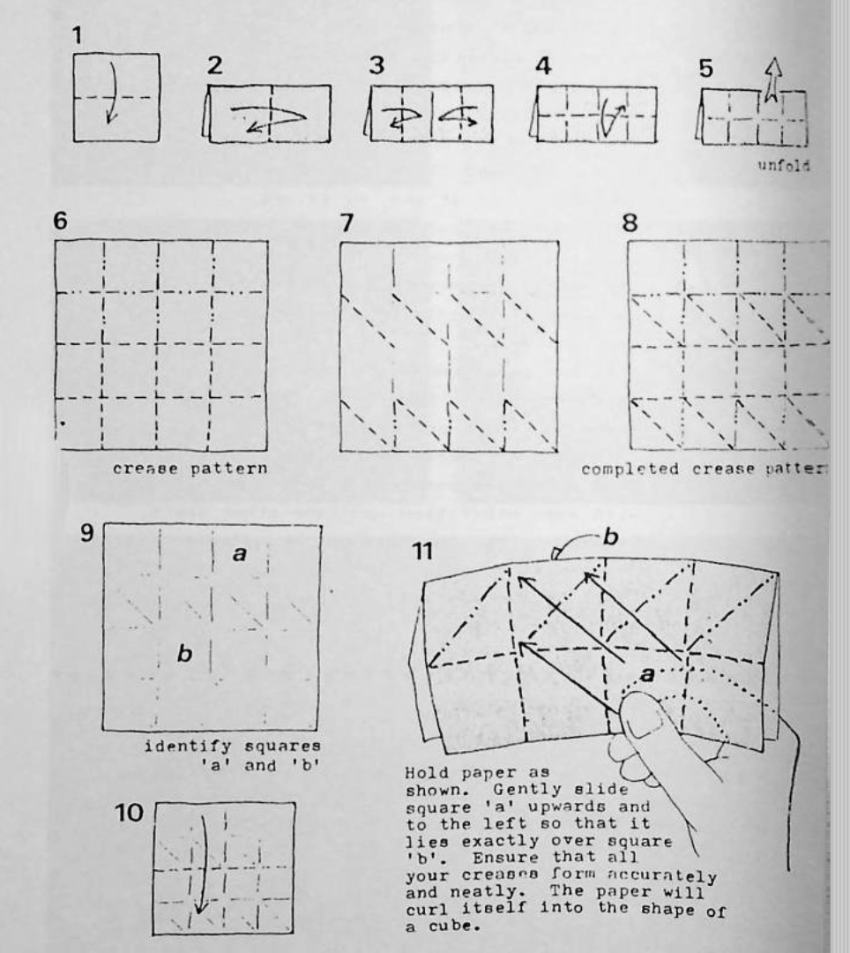
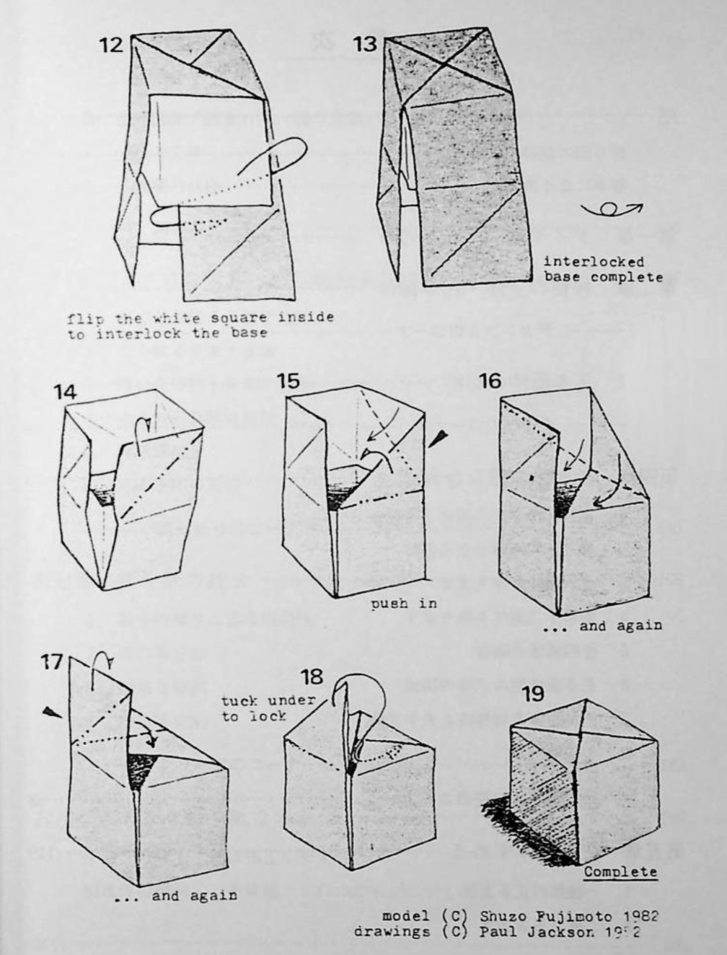
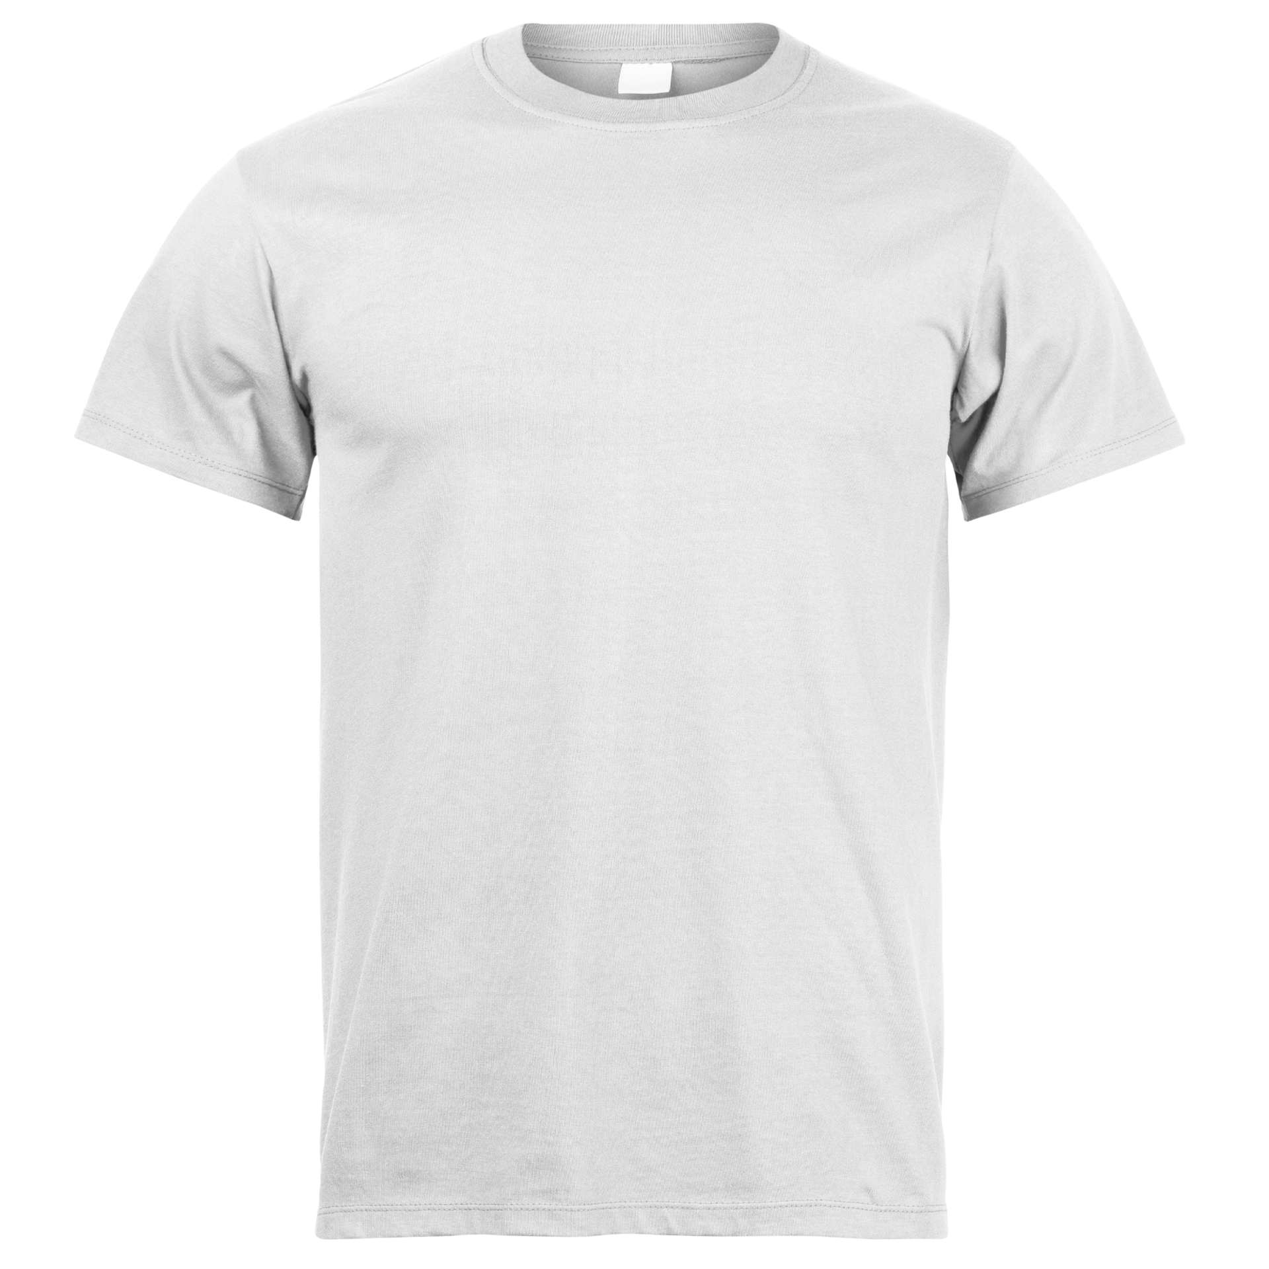
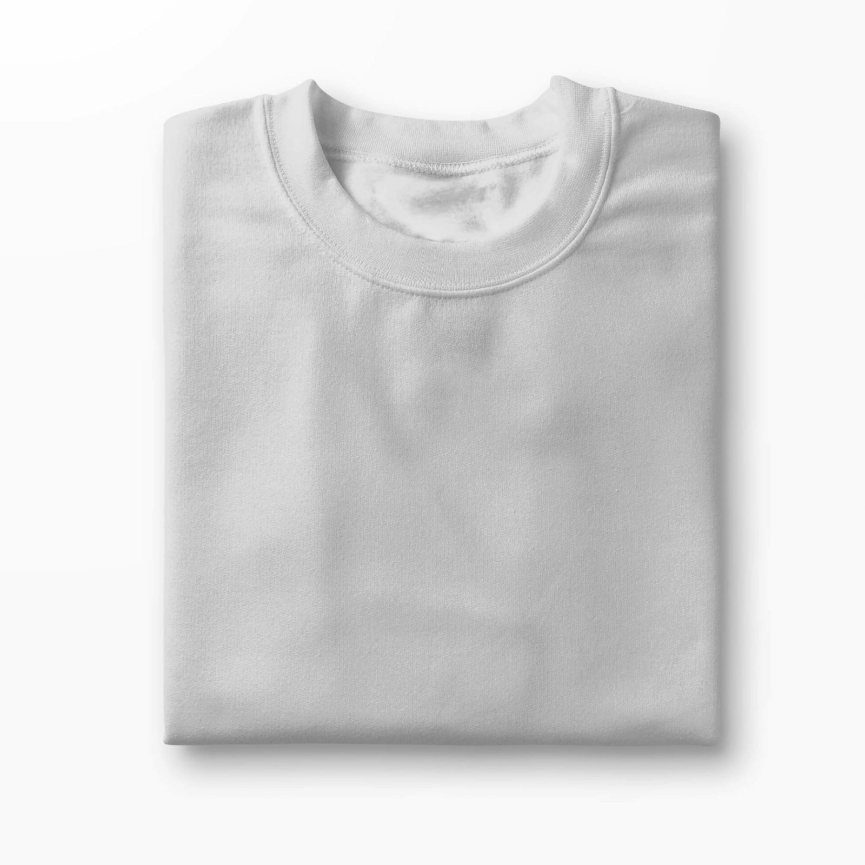
The Bag Folding Problem (Geometry)
Given a foldable shopping bag, how can you fold it up compactly?
Experiment with the shopping bags.
The Perfect Origami Paper (Physics)
What makes the ideal origami paper? Try folding both white sample papers provided. Discuss what properties it has, and whether this makes it well suited for origami.
OR
Tissue Origami (Physics and Geometry)
The thin paper from earlier is called Tissue Paper, and is often used for making floral origami. Image from WikiHow.
The Long Cut Problem (Geometry and Physics)
Given a long piece of fabric, how can you cut a straight line on it with just scissors and a string? What about cardboard?
Olyester Origami (Physics and Geometry)
One unusual Origami Paper is the transparent Olyester Paper.
Using the transparent paper, try folding the Fujimoto cube. What applications do you foresee for such a paper? Instructions from Fujimoto’s book “Invitation to Creative Playing with Origami.”
The Shirt Folding Problem (Physics)
When folding a shirt, it is often ambiguous where to fold vertically. In particular, there must be enough space to make sure the sleeves fit but not too much space that the folded shirt is too large.
Experiment with the pink paper shirts.
Activities, proofs, and illustrations inspired/taken from:
“Project Origami: Activities for Exploring Mathematics” by Thomas Hull in 2006
“Origami Design Secrets” second edition by Robert Lang in 2012
“Twists, Tilings, and Tessellations” by Robert Lang in 2018
ANSWERS:
Bag Folding: Both are theoretically roughly equal but the right is easier.
Long Cut Cardboard: Make the fold and follow it.
Long Cut Fabric: Outline the fold with a string and follow it.
Page 2

